Slide 1
Module 1
Project management
Part 2

Slide 2
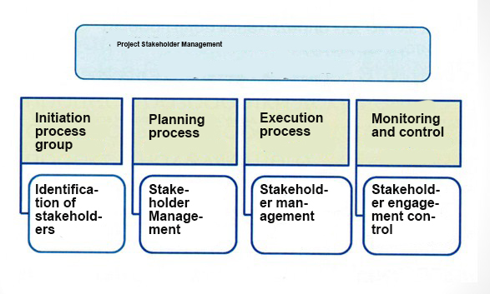

Slide 3

Project Stakeholder stakeholders are a person, group or organization who can influence, or who believe they can influence, or who are affected by the decisions, activities or results of the project.

Slide 4
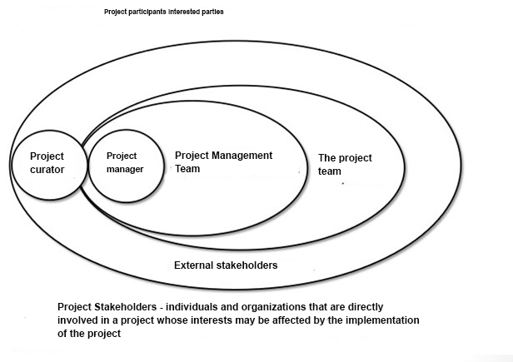

Slide 5
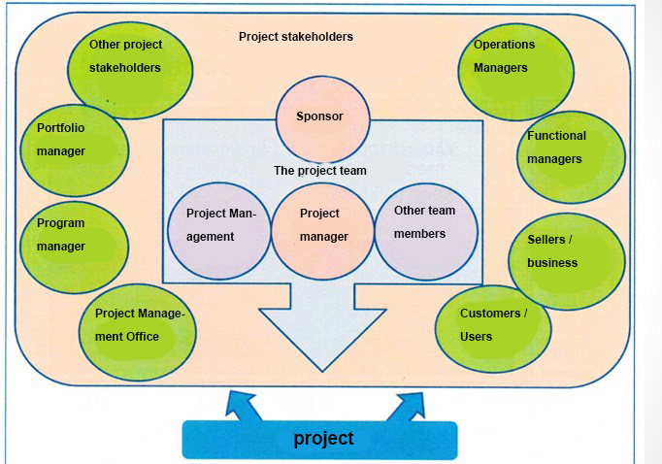

Slide 6
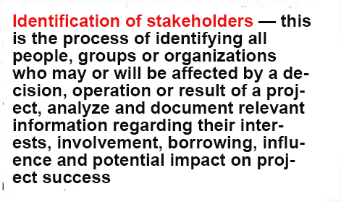

Slide 7
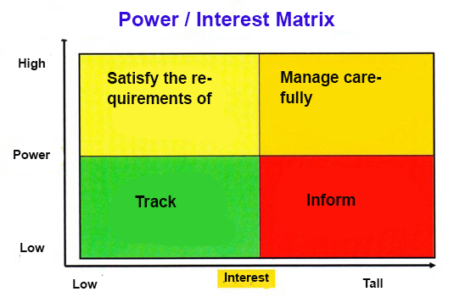

Slide 8
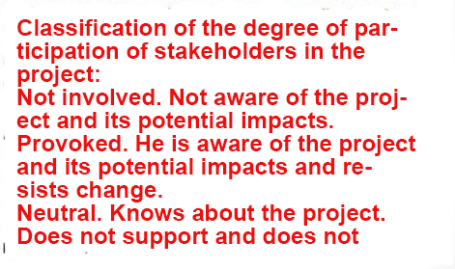

Slide 9
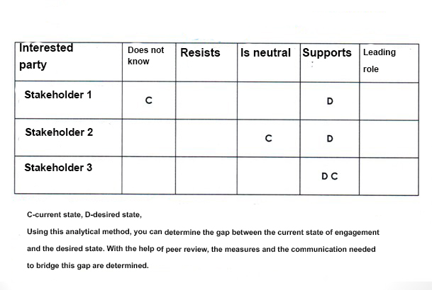

Slide 10
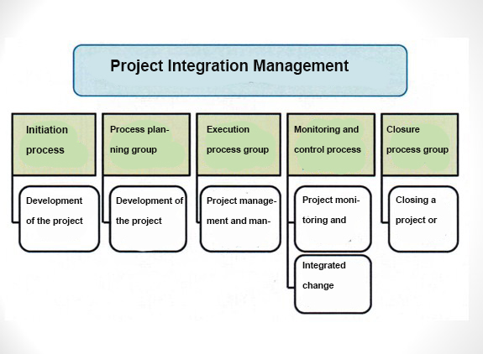

Slide 11
THANKS FOR ATTENTION!!!

